Slide 1

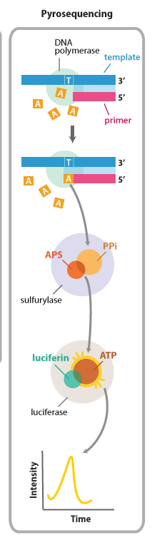

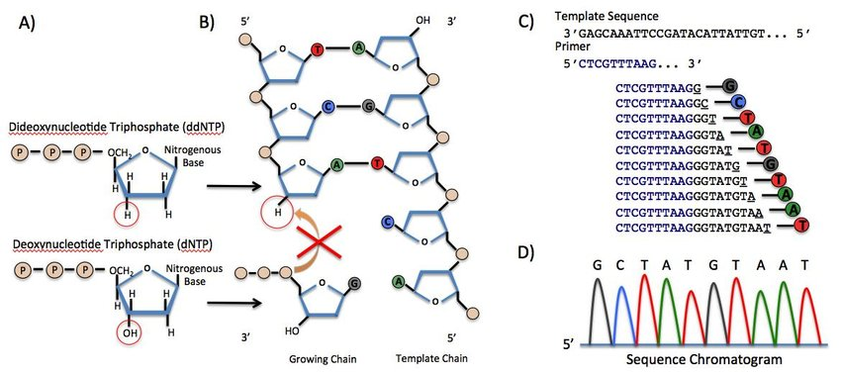
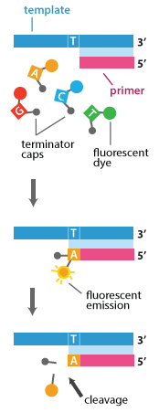
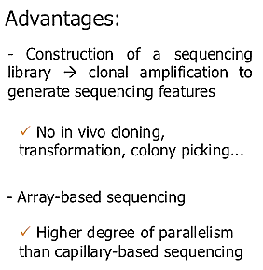
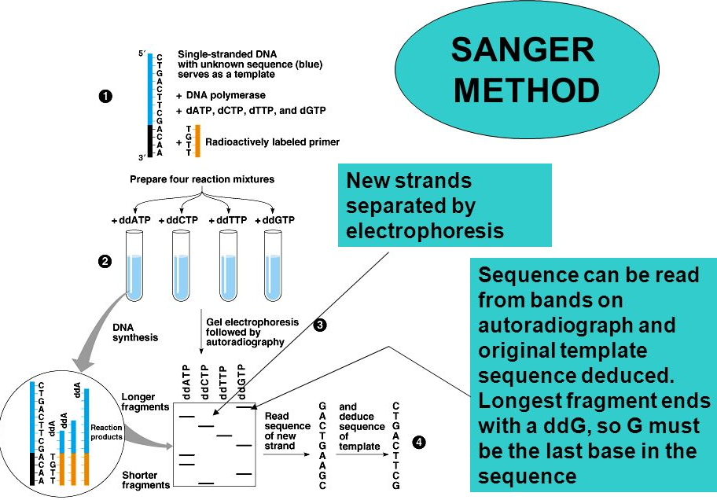
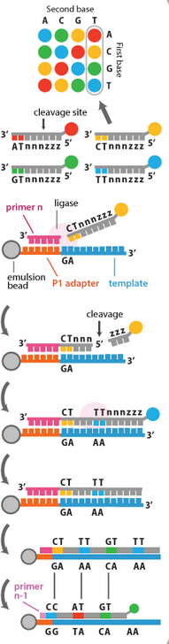
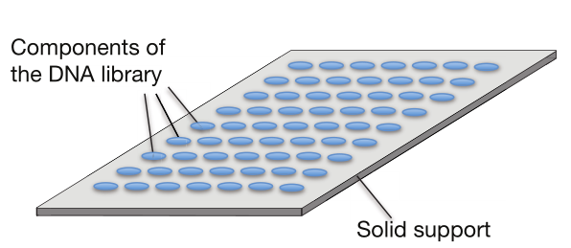
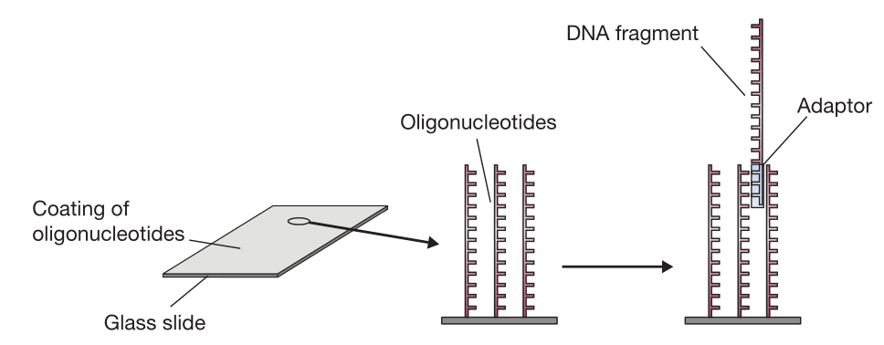
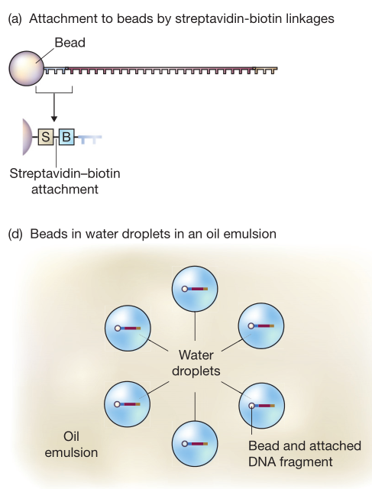
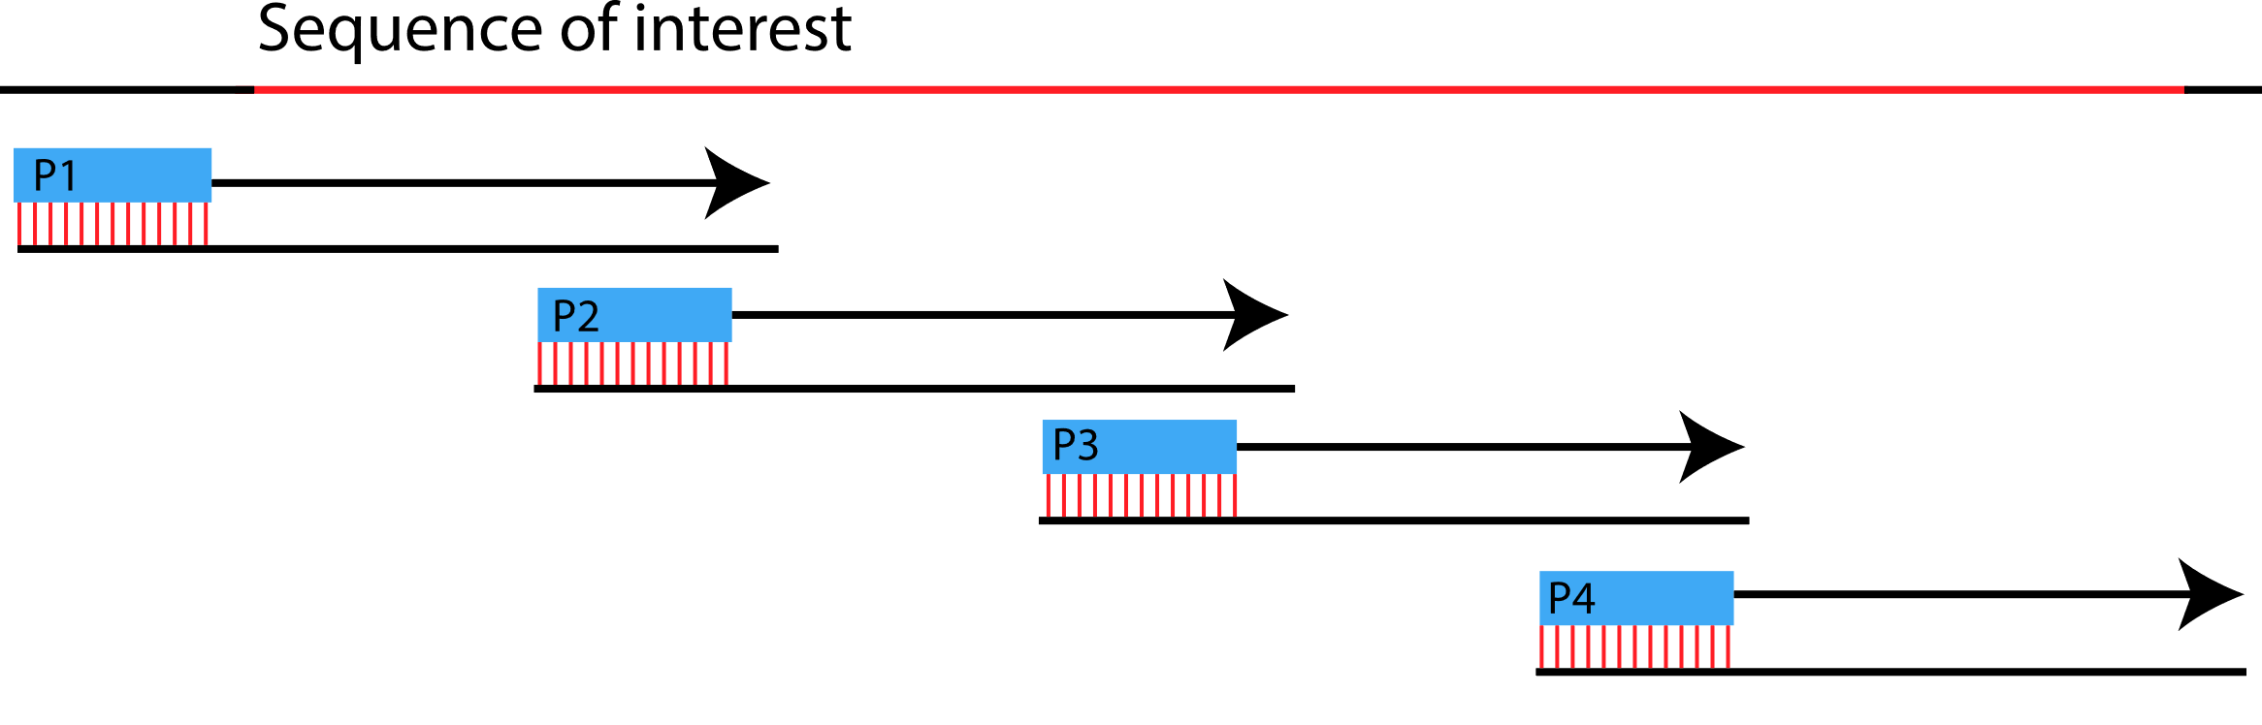
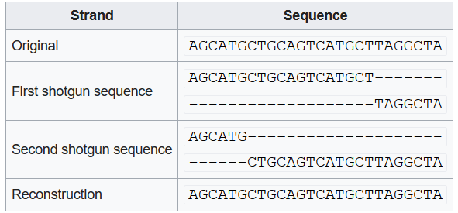
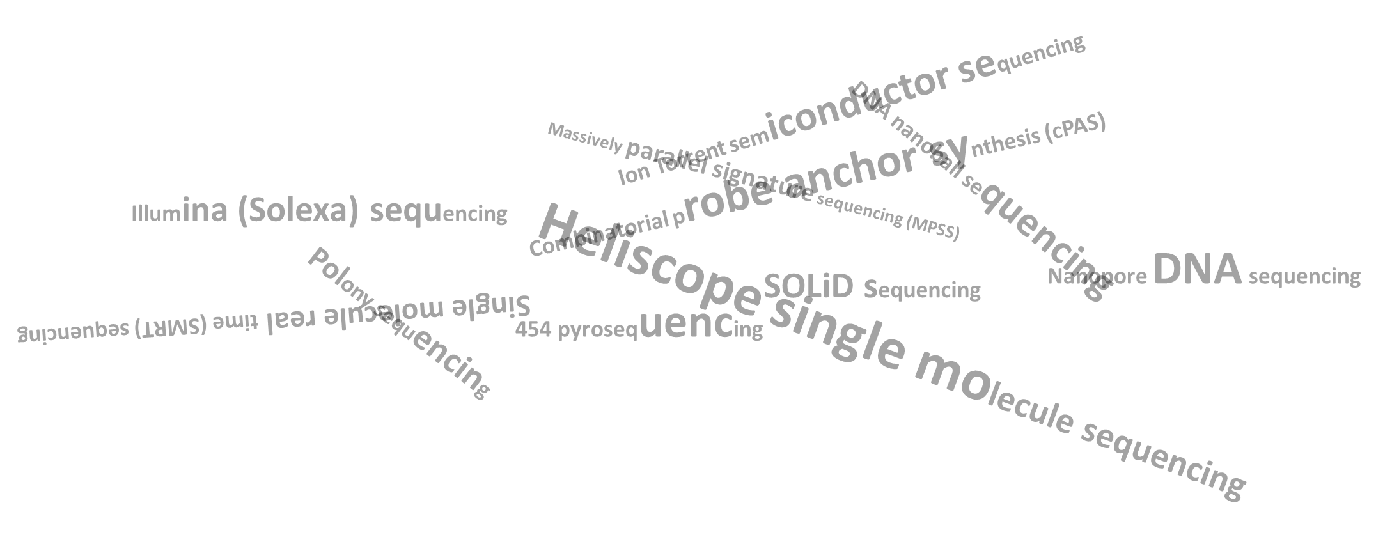
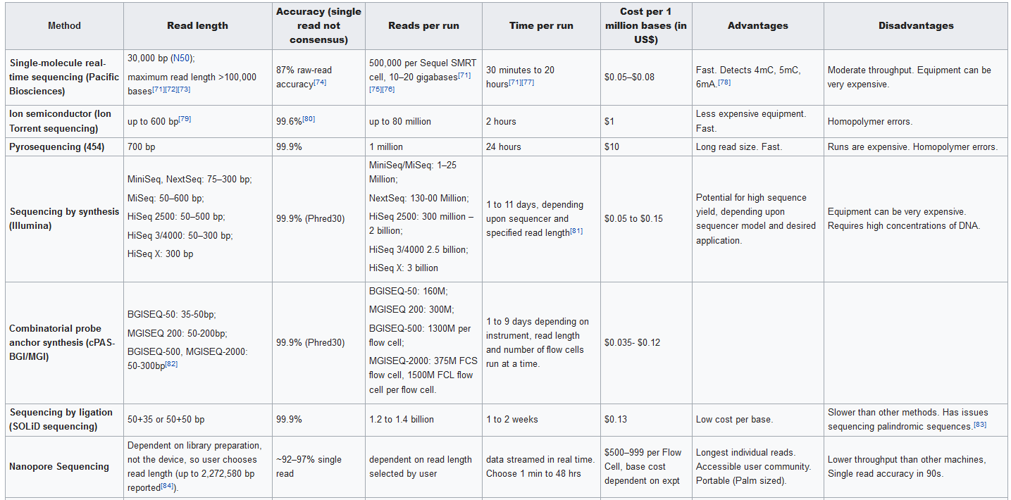
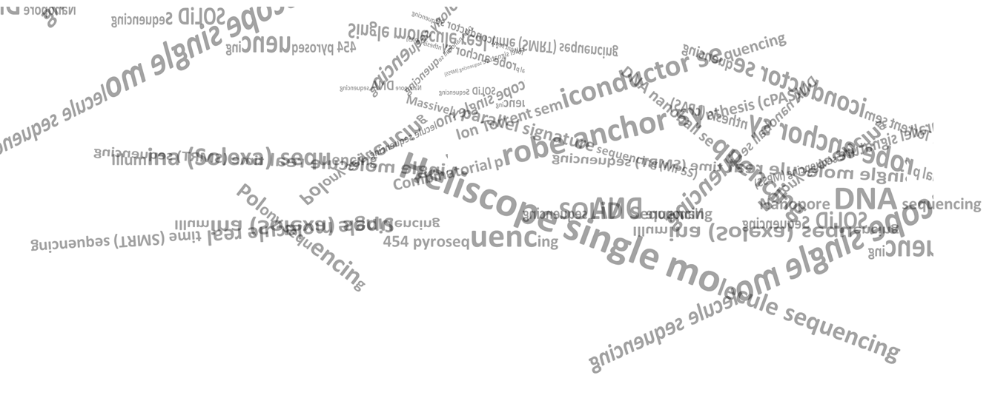
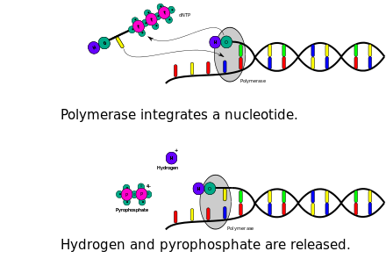

Next generation
A race to unravel the genome
WHY ?
DNA determined the sequence of amino acids in proteins which in turn helped determine the function of a protein and basically everything is governed by there function and localization
Genome Sequencing
Genome Sequencing
The process of determining the nucleic acid sequence – the order of nucleotides in DNA. It includes any method or technology that is used to determine the order of the four bases: adenine, guanine, cytosine, and thymine. The advent of rapid DNA sequencing methods has greatly accelerated biological and medical research and discovery
First generation sequencing
Pyrosequencing
In pyrosequencing, the sequencing reaction is monitored through the release of the pyrophosphate during nucleotide incorporation. A single nucleotide is added to the sequencing chip which will lead to its incorporation in a template dependent manner. This incorporation will result in the release of pyrophosphate which is used in a series of chemical reactions resulting in the generation of light. Light emission is detected by a camera which records the appropriate sequence of the cluster. Any unincorporated bases are degraded by apyrase before the addition of the next nucleotide. This cycle continues until the sequencing reaction is complete
Maxam-Gilbert sequencing
Allan Maxam and Walter Gilbert published a DNA sequencing method in 1977( Two months after the chain termination method ) based on nucleobase-specific partial chemical modification of DNA and subsequent cleavage of the DNA backbone at sites adjacent to the modified nucleotides. Also known as chemical sequencing, this method allowed purified samples of double-stranded DNA to be used without further cloning.
Chain-termination methods
The chain-termination method developed by Frederick Sanger and coworkers in 1977 soon became the method of choice, owing to its relative ease and reliability. When invented, the chain-terminator method used fewer toxic chemicals and lower amounts of radioactivity than the Maxam and Gilbert method.
The Sanger method, in mass production form, is the technology which produced the first human genome in 2001, ushering in the age of genomics.
Next generation or High-throughput sequencing
Sequencing by Synthesis
Sequencing by synthesis utilizes the step-by-step incorporation of reversibly fluorescent and terminated nucleotides for DNA sequencing and is used by the Illumina NGS platforms. The nucleotides used in this method have been modified in two ways:
1) each nucleotide is reversibly attached to a single fluorescent molecule with unique emission wavelengths, and
2) each nucleotide is also reversibly terminated ensuring that only a single nucleotide will be incorporated per cycle.
All four nucleotides are added to the sequencing chip and after nucleotide incorporation the remaining DNA bases are washed away. The fluorescent signal is read at each cluster and recorded; both the fluorescent molecule and the terminator group are then cleaved and washed away. This process is repeated until the sequencing reaction is complete.
Sanger’s method of gene sequencing is also known as dideoxy chain termination method. It generates nested set of labelled fragments from a template strand of DNA to be sequenced by replicating that template strand and interrupting the replication process at one of the four base
The high demand for low-cost sequencing has driven the development of high-throughput sequencing technologies that parallelize the sequencing process, producing thousands or millions of sequences concurrently. High-throughput sequencing technologies are intended to lower the cost of DNA sequencing beyond what is possible with standard dye-terminator methods. In ultra-high-throughput sequencing as many as 500,000 sequencing-by-synthesis operations may be run in parallel. Such technologies led to the ability to sequence an entire human genome in as little as one day
A large library made up of thousands or millions of DNA fragments is sequenced in a single experiment. Often, these fragments represent an entire genome, and in most projects the sequencing experiment is preceded only by DNA extraction
New strands separated by electrophoresis
Sequence can be read from bands on autoradiograph and original template sequence deduced. Longest fragment ends with a ddG, so G Must be the last base in the sequence
Preparation of a next-generation sequencing library
Although several different next-generation sequencing methods are available, they all begin with the preparation of a library of DNA fragments that have been immobilized on a solid support, in such a way that the individual sequencing reactions can be carried out side-by-side in an array format
Sequencing by Ligation
Sequencing by ligation does not utilize a DNA polymerase to incorporate nucleotides. Instead, it relies on short oligonucleotide probes that are ligated to one another. These oligonucleotides consist of 8 bases (from 3’-5’): two probe specific bases (there are a total of 16 8-mer probes which all differ at these two base positions) and six degenerate bases; one of four fluorescent dyes are attached at the 5’ end of the probe. The sequencing reaction commences by binding of the primer to the adapter sequence and then hybridization of the appropriate probe. This hybridization of the probe is guided by the two probe specific bases and upon annealing, is ligated to the primer sequence through a DNA ligase. Unbound oligonucleotides are washed away, the signal is detected and recorded, the fluorescent signal is cleaved (the last 3 bases), and then the next cycle commences. After approximately 7 cycles of ligation the DNA strand is denatured and another sequencing primer, offset by one base from the previous primer, is used to repeat these steps - in total 5 sequencing primers are used
Library preparation begins with purification of the DNA to be sequenced, which is usually total cell DNA from the organism whose genome is being studied. The DNA is then broken into fragments, usually between 100 bp and 500 bp in length, with the precise sizes depending on the lengths of the individual sequences that can be obtained by the next-generation method being employed. The standard fragmentation method is sonication, in which ultrasound is used to cause breaks in the DNA molecules. The sonicated DNA is then fractionated by agarose gel electrophoresis, and fragments of the desired size purified from the gel
Sonication is the preferred fragmentation method because it causes breaks at random
positions in DNA molecules. Random breakage is important to ensure that all parts of
the starting DNA are sequenced
If a restriction endonuclease were used to break up the DNA, some fragments
might be too long to be sequenced entirely from their ends, and the internal regions
of these fragments would therefore be absent from the final set of sequence reads that is obtained
The chain termination method of DNA sequencing ("Sanger sequencing") can only be used for short DNA strands of 100 to 1000 base pairs. Due to this size limit, longer sequences are subdivided into smaller fragments that can be sequenced separately, and these sequences are assembled to give the overall sequence
The DNA fragments that make up the library cannot be directly immobilized on to a solid support. First, adaptors must be attached to the ends of the fragments. The exact role of these adaptors in library immobilization depends on the particular sequencing method being used
There are two principal methods for this fragmentation and sequencing process. Primer walking (or "chromosome walking") progresses through the entire strand piece by piece, whereas Shotgun sequencing is a faster but more complex process that uses random fragments
In the first method, the solid support is a glass slide that has been coated with many copies of a short oligonucleotide. The sequence of this oligonucleotide matches the ends of the adaptors. The fragments are therefore denatured into single-stranded DNA. The single-stranded molecules then attach to the glass slide by base pairing between their adaptor sequences and the immobilized oligonucleotides
Primer walking (aka Directed Sequencing) is a sequencing method of choice for sequencing DNA fragments between 1.3 and 7 kilobases. Such fragments are too long to be sequenced in a single sequence read using the chain termination method. This method works by dividing the long sequence into several consecutive short ones
DNA is broken up randomly into numerous small segments, which are sequenced using the chain termination method to obtain reads. Multiple overlapping reads for the target DNA are obtained by performing several rounds of this fragmentation and sequencing. Computer programs then use the overlapping ends of different reads to assemble them into a continuous sequence
In the second method, the solid support is provided by small metallic beads that are coated with streptavidin. One of the adaptors has a biotin label attached to its 5 ′ end. DNA fragments therefore become attached to the beads by biotin–streptavidin linkages. The ratio of DNA fragments to beads is set so that, on average, just one fragment becomes attached to each bead. The beads are then shaken in an oil–water mixture, with the conditions again carefully controlled so that there is just one bead in each aqueous droplet within the emulsion. These aqueous droplets are transferred into wells on a plastic strip, one droplet per well, with thousands of wells in total
A primer that matches the beginning of the DNA to sequence is used to synthesize a short DNA strand adjacent to the unknown sequence, starting with the primer.
The new short DNA strand is sequenced using the chain termination method.
The end of the sequenced strand is used as a primer for the next part of the long DNA sequence, hence the term "walking".
Next-generation sequencing methods
Various NGS platforms comparison
Each DNA fragment is attached to a single bead via a streptavidin–biotin linkage
Individual beads, with their attached DNA fragments, are placed within water droplets in an oil–water emulsion
Most Known
Pyrosequencing
Sequencing by Synthesis
Sequencing by Ligation
Ion Semiconductor Sequencing
In reality, this process uses enormous amounts of information that are rife with ambiguities and sequencing errors. Assembly of complex genomes is additionally complicated by the great abundance of repetitive sequences, meaning similar short reads could come from completely different parts of the sequence
Aligning the heavy output (sequence data) generated
Ion Semiconductor Sequencing
Ion semiconductor sequencing utilizes the release of hydrogen ions during the sequencing reaction to detect the sequence of a cluster. Each cluster is located directly above a semiconductor transistor which is capable of detecting changes in the pH of the solution. During nucleotide incorporation, a single H+ is released into the solution and it is detected by the semiconductor. The sequencing reaction itself proceeds similarly to pyrosequencing but at a fraction of the cost
Through the use of high end programs (software) generated data is synchronized and aligned

Slide 2
Next generation
A race to unravel the genome
WHY ?
DNA determined the sequence of amino acids in proteins which in turn helped determine the function of a protein and basically everything is governed by there function and localization
Genome Sequencing
Genome Sequencing
The process of determining the nucleic acid sequence – the order of nucleotides in DNA. It includes any method or technology that is used to determine the order of the four bases: adenine, guanine, cytosine, and thymine. The advent of rapid DNA sequencing methods has greatly accelerated biological and medical research and discovery
First generation sequencing
Pyrosequencing
In pyrosequencing, the sequencing reaction is monitored through the release of the pyrophosphate during nucleotide incorporation. A single nucleotide is added to the sequencing chip which will lead to its incorporation in a template dependent manner. This incorporation will result in the release of pyrophosphate which is used in a series of chemical reactions resulting in the generation of light. Light emission is detected by a camera which records the appropriate sequence of the cluster. Any unincorporated bases are degraded by apyrase before the addition of the next nucleotide. This cycle continues until the sequencing reaction is complete
Maxam-Gilbert sequencing
Allan Maxam and Walter Gilbert published a DNA sequencing method in 1977( Two months after the chain termination method ) based on nucleobase-specific partial chemical modification of DNA and subsequent cleavage of the DNA backbone at sites adjacent to the modified nucleotides. Also known as chemical sequencing, this method allowed purified samples of double-stranded DNA to be used without further cloning.
Chain-termination methods
The chain-termination method developed by Frederick Sanger and coworkers in 1977 soon became the method of choice, owing to its relative ease and reliability. When invented, the chain-terminator method used fewer toxic chemicals and lower amounts of radioactivity than the Maxam and Gilbert method.
The Sanger method, in mass production form, is the technology which produced the first human genome in 2001, ushering in the age of genomics.
Next generation or High-throughput sequencing
Sequencing by Synthesis
Sequencing by synthesis utilizes the step-by-step incorporation of reversibly fluorescent and terminated nucleotides for DNA sequencing and is used by the Illumina NGS platforms. The nucleotides used in this method have been modified in two ways:
1) each nucleotide is reversibly attached to a single fluorescent molecule with unique emission wavelengths, and
2) each nucleotide is also reversibly terminated ensuring that only a single nucleotide will be incorporated per cycle.
All four nucleotides are added to the sequencing chip and after nucleotide incorporation the remaining DNA bases are washed away. The fluorescent signal is read at each cluster and recorded; both the fluorescent molecule and the terminator group are then cleaved and washed away. This process is repeated until the sequencing reaction is complete.
Sanger’s method of gene sequencing is also known as dideoxy chain termination method. It generates nested set of labelled fragments from a template strand of DNA to be sequenced by replicating that template strand and interrupting the replication process at one of the four base
The high demand for low-cost sequencing has driven the development of high-throughput sequencing technologies that parallelize the sequencing process, producing thousands or millions of sequences concurrently. High-throughput sequencing technologies are intended to lower the cost of DNA sequencing beyond what is possible with standard dye-terminator methods. In ultra-high-throughput sequencing as many as 500,000 sequencing-by-synthesis operations may be run in parallel. Such technologies led to the ability to sequence an entire human genome in as little as one day
A large library made up of thousands or millions of DNA fragments is sequenced in a single experiment. Often, these fragments represent an entire genome, and in most projects the sequencing experiment is preceded only by DNA extraction
New strands separated by electrophoresis
Sequence can be read from bands on autoradiograph and original template sequence deduced. Longest fragment ends with a ddG, so G Must be the last base in the sequence
Preparation of a next-generation sequencing library
Although several different next-generation sequencing methods are available, they all begin with the preparation of a library of DNA fragments that have been immobilized on a solid support, in such a way that the individual sequencing reactions can be carried out side-by-side in an array format
Sequencing by Ligation
Sequencing by ligation does not utilize a DNA polymerase to incorporate nucleotides. Instead, it relies on short oligonucleotide probes that are ligated to one another. These oligonucleotides consist of 8 bases (from 3’-5’): two probe specific bases (there are a total of 16 8-mer probes which all differ at these two base positions) and six degenerate bases; one of four fluorescent dyes are attached at the 5’ end of the probe. The sequencing reaction commences by binding of the primer to the adapter sequence and then hybridization of the appropriate probe. This hybridization of the probe is guided by the two probe specific bases and upon annealing, is ligated to the primer sequence through a DNA ligase. Unbound oligonucleotides are washed away, the signal is detected and recorded, the fluorescent signal is cleaved (the last 3 bases), and then the next cycle commences. After approximately 7 cycles of ligation the DNA strand is denatured and another sequencing primer, offset by one base from the previous primer, is used to repeat these steps - in total 5 sequencing primers are used
Library preparation begins with purification of the DNA to be sequenced, which is usually total cell DNA from the organism whose genome is being studied. The DNA is then broken into fragments, usually between 100 bp and 500 bp in length, with the precise sizes depending on the lengths of the individual sequences that can be obtained by the next-generation method being employed. The standard fragmentation method is sonication, in which ultrasound is used to cause breaks in the DNA molecules. The sonicated DNA is then fractionated by agarose gel electrophoresis, and fragments of the desired size purified from the gel
Sonication is the preferred fragmentation method because it causes breaks at random
positions in DNA molecules. Random breakage is important to ensure that all parts of
the starting DNA are sequenced
If a restriction endonuclease were used to break up the DNA, some fragments
might be too long to be sequenced entirely from their ends, and the internal regions
of these fragments would therefore be absent from the final set of sequence reads that is obtained
The chain termination method of DNA sequencing ("Sanger sequencing") can only be used for short DNA strands of 100 to 1000 base pairs. Due to this size limit, longer sequences are subdivided into smaller fragments that can be sequenced separately, and these sequences are assembled to give the overall sequence
The DNA fragments that make up the library cannot be directly immobilized on to a solid support. First, adaptors must be attached to the ends of the fragments. The exact role of these adaptors in library immobilization depends on the particular sequencing method being used
There are two principal methods for this fragmentation and sequencing process. Primer walking (or "chromosome walking") progresses through the entire strand piece by piece, whereas Shotgun sequencing is a faster but more complex process that uses random fragments
In the first method, the solid support is a glass slide that has been coated with many copies of a short oligonucleotide. The sequence of this oligonucleotide matches the ends of the adaptors. The fragments are therefore denatured into single-stranded DNA. The single-stranded molecules then attach to the glass slide by base pairing between their adaptor sequences and the immobilized oligonucleotides
Primer walking (aka Directed Sequencing) is a sequencing method of choice for sequencing DNA fragments between 1.3 and 7 kilobases. Such fragments are too long to be sequenced in a single sequence read using the chain termination method. This method works by dividing the long sequence into several consecutive short ones
DNA is broken up randomly into numerous small segments, which are sequenced using the chain termination method to obtain reads. Multiple overlapping reads for the target DNA are obtained by performing several rounds of this fragmentation and sequencing. Computer programs then use the overlapping ends of different reads to assemble them into a continuous sequence
In the second method, the solid support is provided by small metallic beads that are coated with streptavidin. One of the adaptors has a biotin label attached to its 5 ′ end. DNA fragments therefore become attached to the beads by biotin–streptavidin linkages. The ratio of DNA fragments to beads is set so that, on average, just one fragment becomes attached to each bead. The beads are then shaken in an oil–water mixture, with the conditions again carefully controlled so that there is just one bead in each aqueous droplet within the emulsion. These aqueous droplets are transferred into wells on a plastic strip, one droplet per well, with thousands of wells in total
Various NGS platforms comparison
Each DNA fragment is attached to a single bead via a streptavidin–biotin linkage
A primer that matches the beginning of the DNA to sequence is used to synthesize a short DNA strand adjacent to the unknown sequence, starting with the primer.
The new short DNA strand is sequenced using the chain termination method.
The end of the sequenced strand is used as a primer for the next part of the long DNA sequence, hence the term "walking".
Individual beads, with their attached DNA fragments, are placed within water droplets in an oil–water emulsion
In reality, this process uses enormous amounts of information that are rife with ambiguities and sequencing errors. Assembly of complex genomes is additionally complicated by the great abundance of repetitive sequences, meaning similar short reads could come from completely different parts of the sequence
Next-generation sequencing methods
Most Known
Pyrosequencing
Sequencing by Synthesis
Sequencing by Ligation
Ion Semiconductor Sequencing
Ion Semiconductor Sequencing
Ion semiconductor sequencing utilizes the release of hydrogen ions during the sequencing reaction to detect the sequence of a cluster. Each cluster is located directly above a semiconductor transistor which is capable of detecting changes in the pH of the solution. During nucleotide incorporation, a single H+ is released into the solution and it is detected by the semiconductor. The sequencing reaction itself proceeds similarly to pyrosequencing but at a fraction of the cost
Aligning the heavy output (sequence data) generated
Through the use of high end programs (software) generated data is synchronized and aligned

